Slide 1
Unleashing Creativity with ChatGPT for Slide Creation
Old Man Yells at ChatGPT
A Journey from Clever Prompts to Automated PowerPoint Magic

Slide 2
Welcome, everyone!
Today, we're going to explore the magic of using ChatGPT to create dynamic slide decks. Buckle up for a journey that's as entertaining as a roller coaster ride!

Slide 3
Meet ChatGPT, Your Creative Partner
With language prowess, problem-solving skills, and digital magic, ChatGPT spins thoughts into gold.

Slide 4
The Creative Process
Crafting a stunning slide deck is an art. Our journey involves:
Crafting the Perfect Prompt
Guiding ChatGPT's Responses
Automating PowerPoint with VBA

Slide 5
Crafting the Perfect Prompt
Your prompt is the roadmap for ChatGPT's creativity. Make it specific, clear, and sometimes sprinkle it with a touch of humor to keep things interesting!

Slide 6
Guiding ChatGPT's Responses
ChatGPT loves a clear briefing! Use specific instructions, suggest a style, and don't hesitate to add a playful twist. Just don't expect it to tell knock-knock jokes... yet!

Slide 7
Automating PowerPoint with VBA
Enter VBA, your PowerPoint enchantment spell. With a sprinkle of code, VBA automates the tedious stuff. Think of it as your digital fairy godmother!

Slide 8
Putting it All Together
Let's see the magic in action:
Craft a prompt: 'Design a slide showcasing our team's accomplishments.'
Generate ChatGPT's response: 'Create a title slide with key achievements and visuals.'
Convert response to VBA: 'VBA code to add title and content slide.'

Slide 9
Benefits of ChatGPT for Slide Creation
Benefits of teaming up with ChatGPT:
Fast like a caffeinated cheetah, even under pressure!
Effortless creativity: ChatGPT's brainpower meets your imagination.
Collaboration without time zone or coffee break constraints.

Slide 10



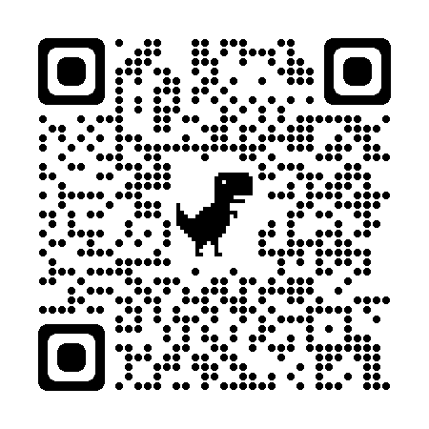



Thank You! Questions? Contact Me:
https://www.linkedin.com/in/aaccioly
@anthony@Accioly.social
https://stackoverflow.com/users/664577
https://accioly.dev
anthony@accioly.dev
Thank you for joining us on this creative adventure! Remember, with ChatGPT and a sprinkle of VBA, you can turn ideas into reality, one slide at a time.
Old Man Yells at ChatGPT © 2023 by Anthony Accioly is licensed under CC BY-SA 4.0
https://github.com/aaccioly-demos/old-man-yells-at-chatgpt

